Slide 1
Option Flow Analysis/Visualization

Slide 2
Functions include:
Historical price data gathered via Alpaca API.
Top 20 largest stocks open interest comparison.
Top 20 largest stocks open interest change comparison.
Charted call options.
Charted put options.
3D scatter plot of open interests.
Individual stock report.

Slide 3
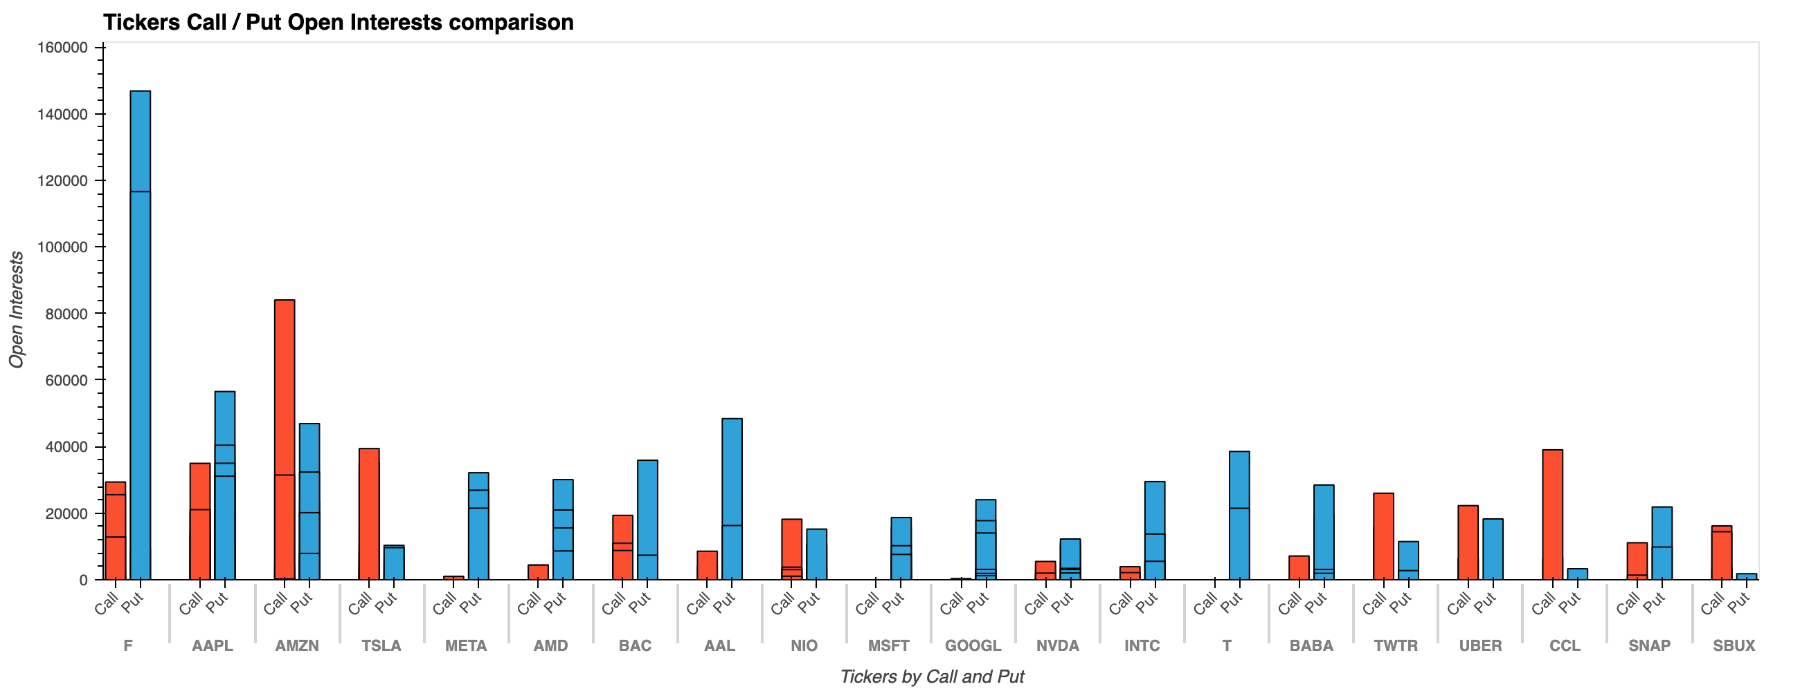
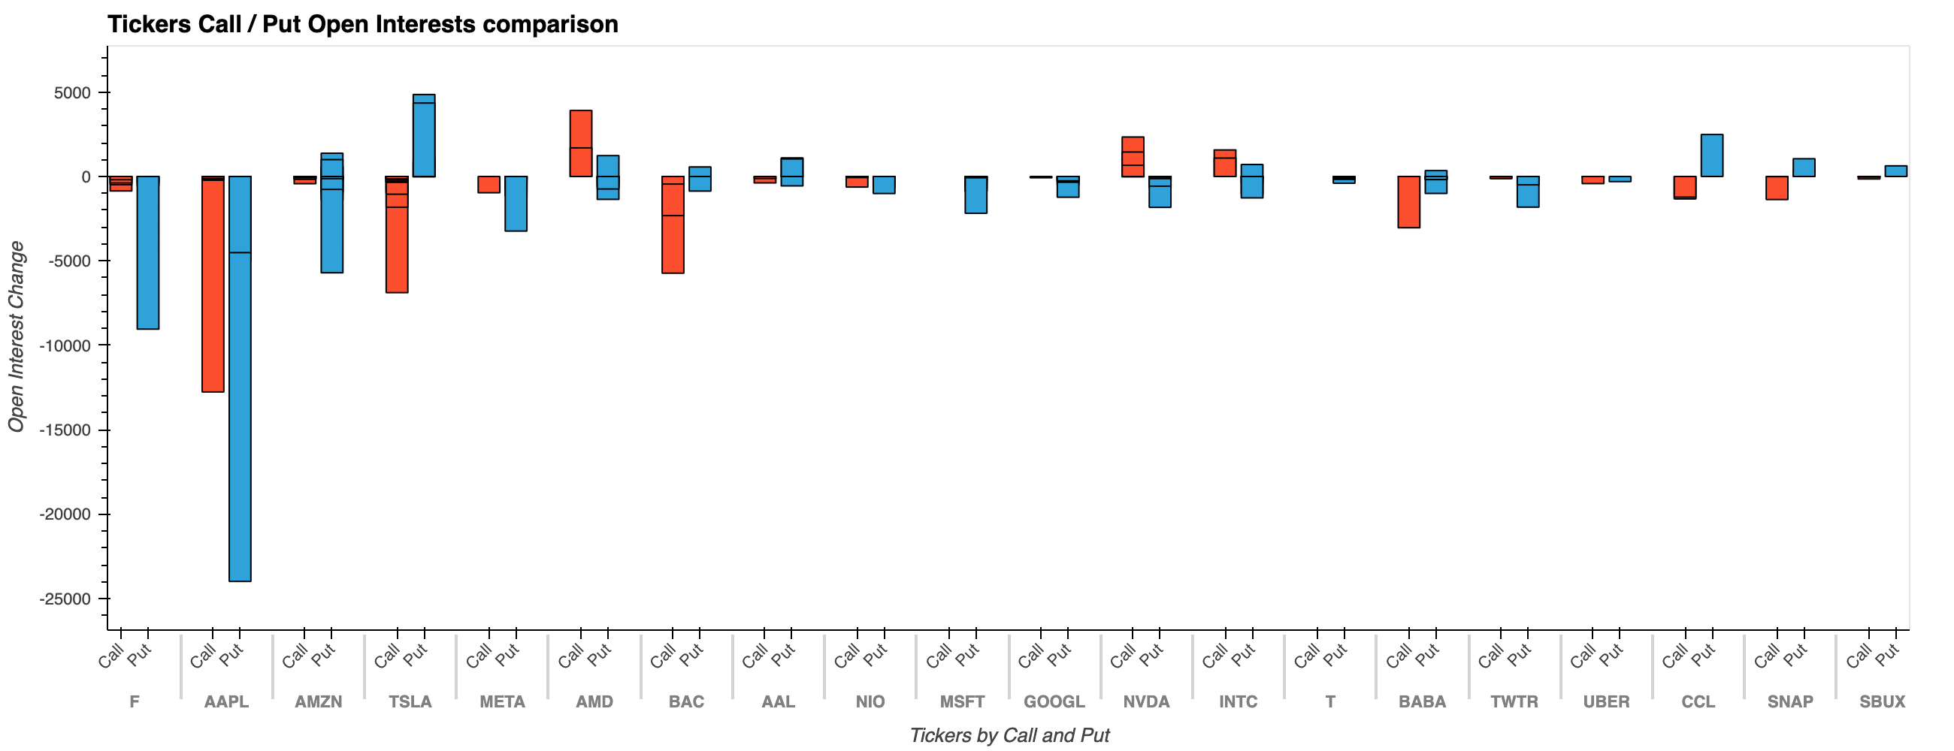
Top 20 Largest:

Slide 4
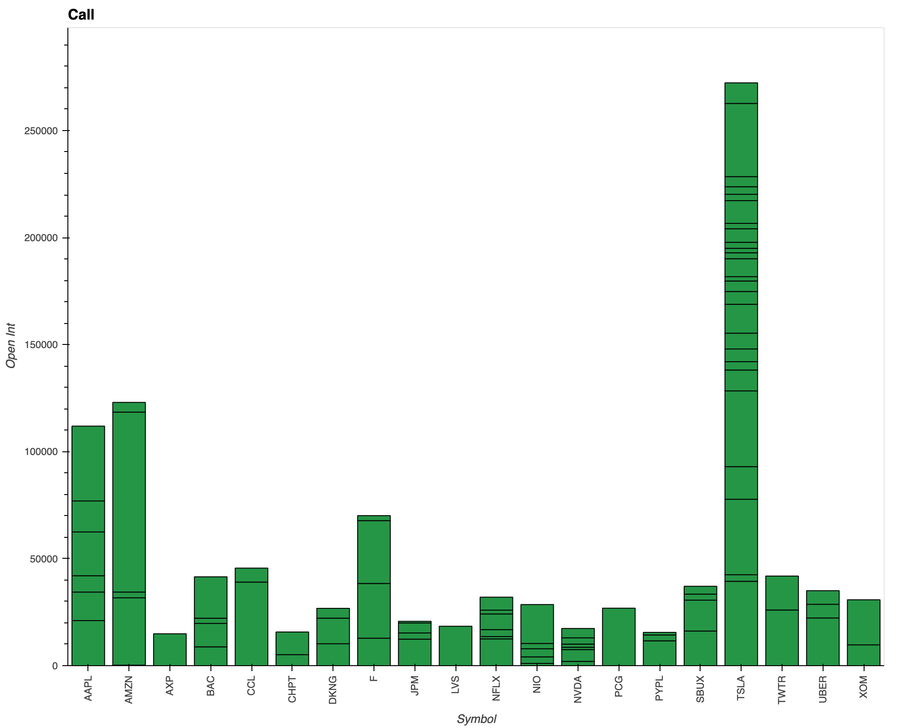
Calls:

Slide 5
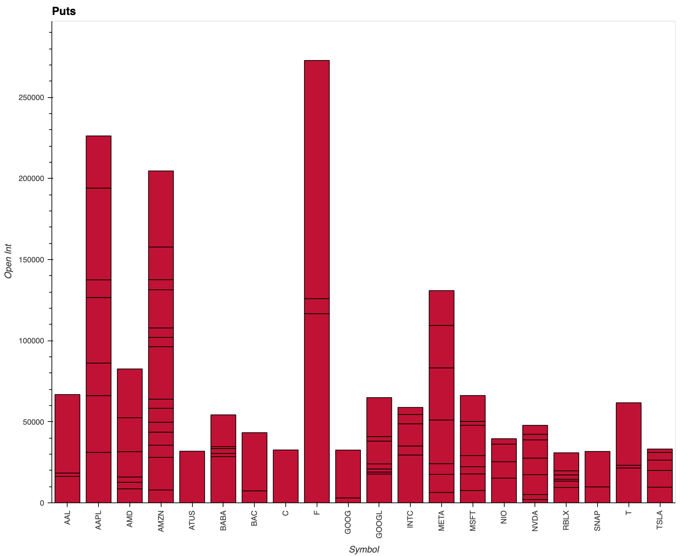
Puts:

Slide 6
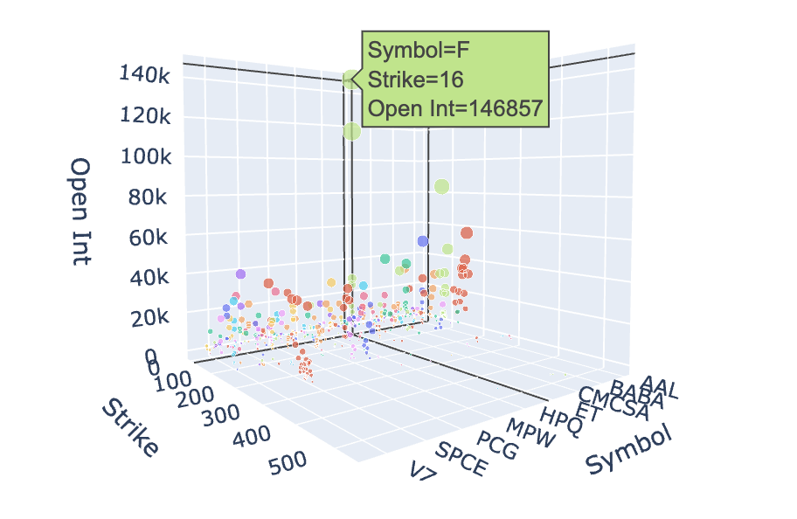
3D Scatter Plot:

Slide 7
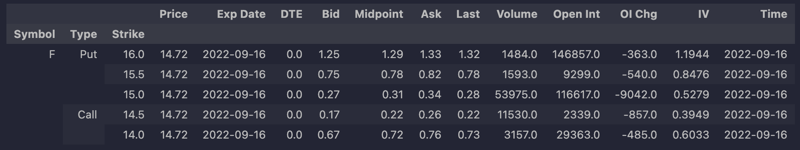
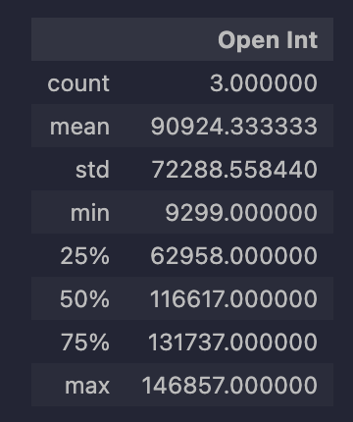
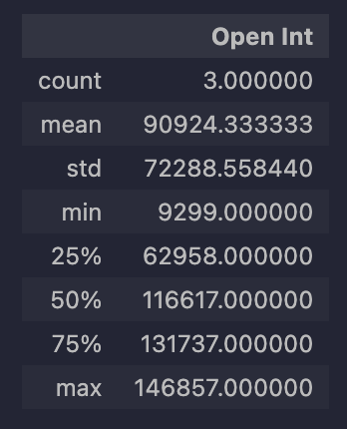
Ford – Options Report - part 1
Call Stats:
Put Stats:

Slide 8
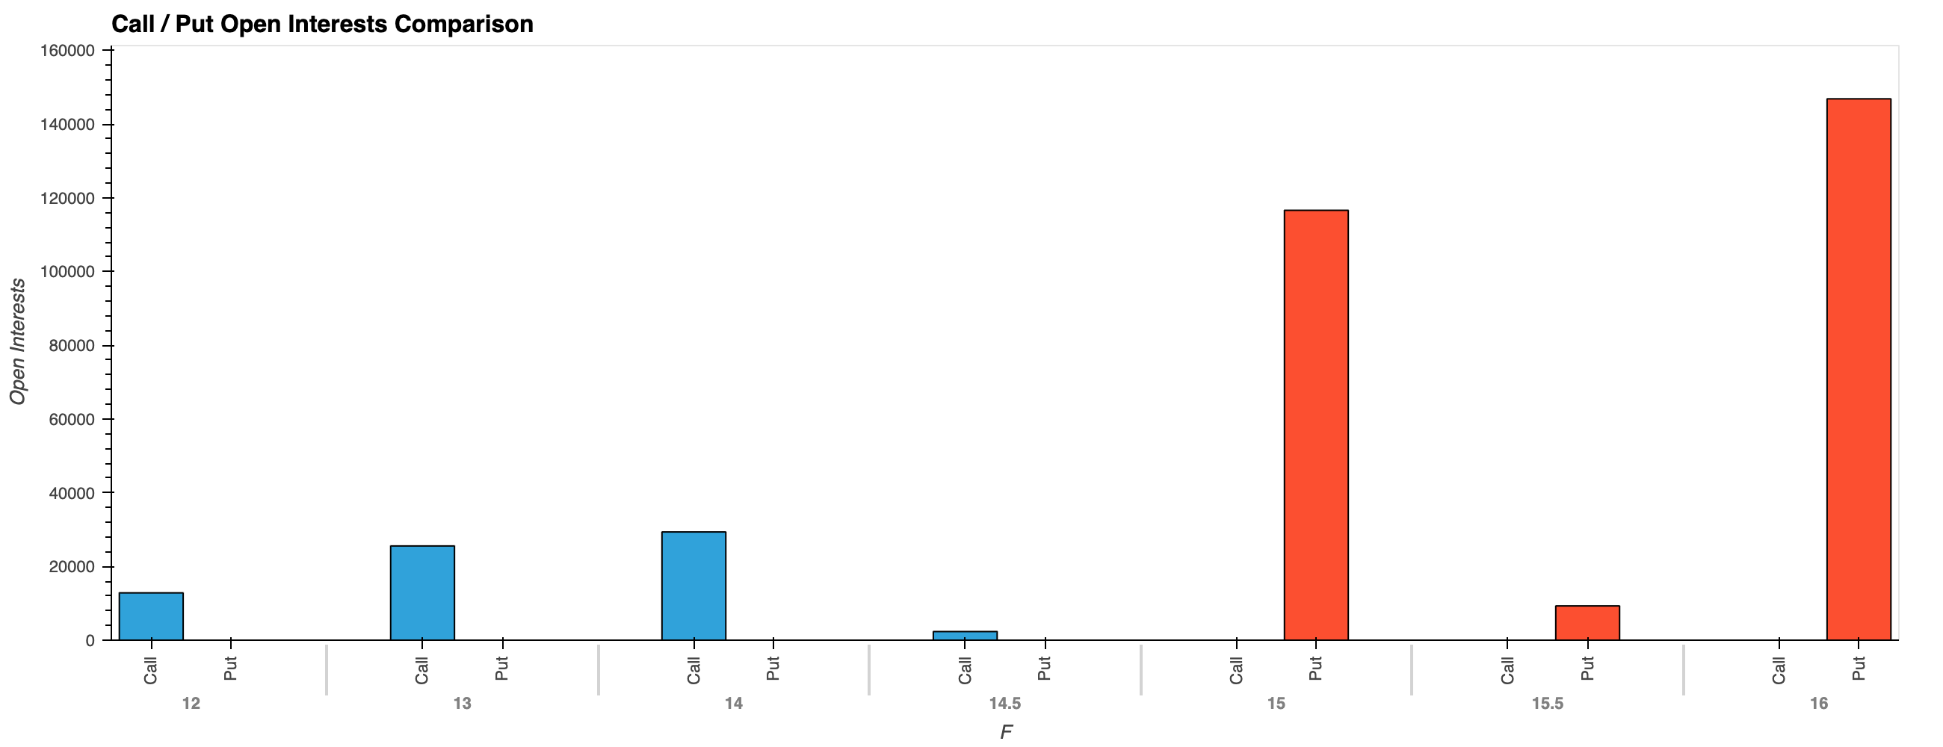
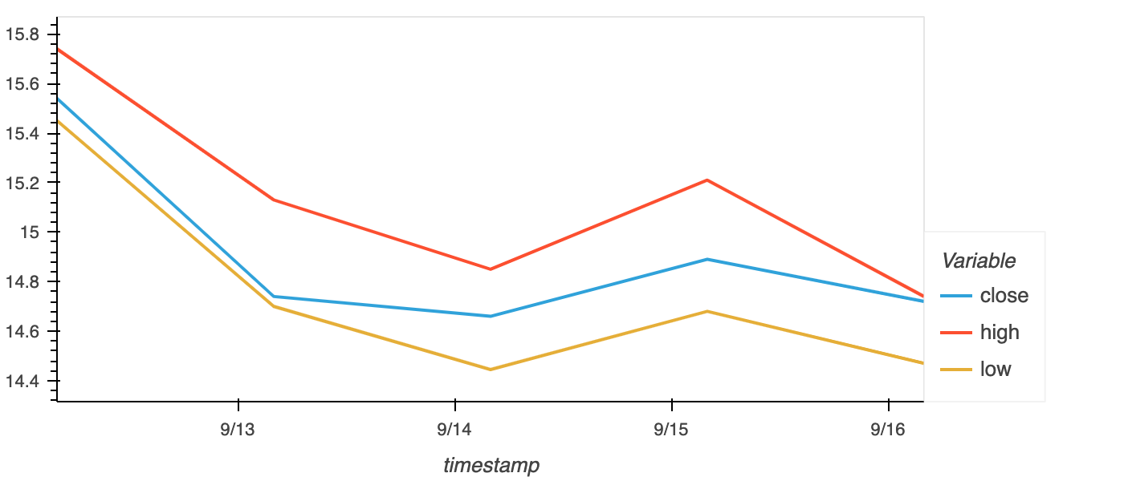
Ford – Options Report - part 2

Slide 9
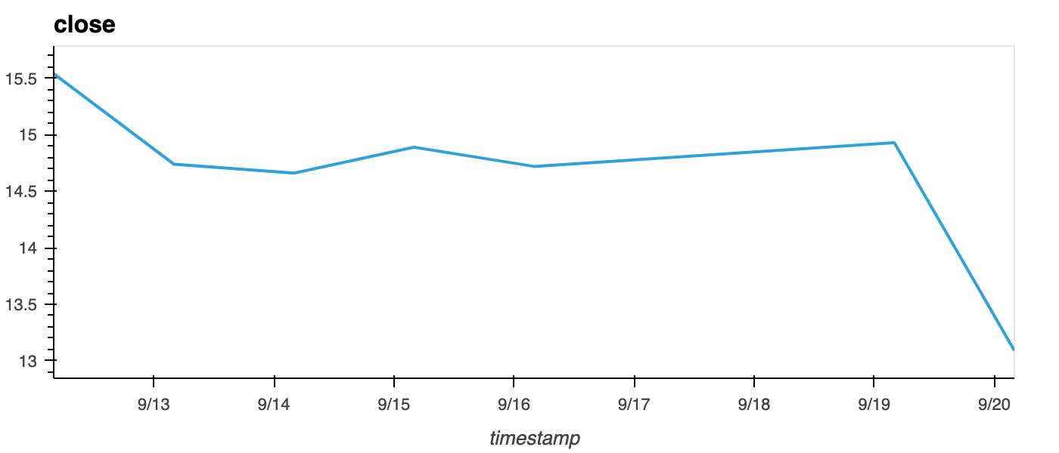
Ford – Options Report - part 3

